Slide 1
Credit card default
NITHARWAL ASHWANI
NOOR AYESHA
NGUYEN THI QUYNH ANH

Slide 2
INTRODUCTION
Pre-process data & Base Table
Feature Reduction
Modeling

Slide 3
1. Preprocess Data & Base Table

Slide 4
Pre-processing data
Check columns, column types
Remove skewness of the numerical columns or standardize data
Checking and treating missing value (NA)
Checking outliers
Creating new variables and dummies variable
(creating 0 column for dummies column does not present in test data)

Slide 5
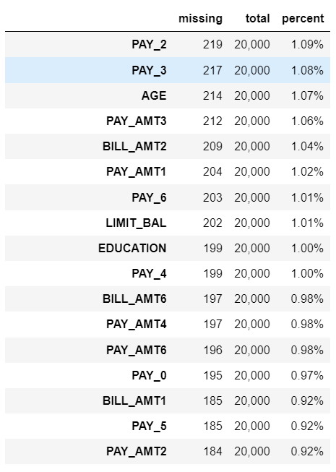
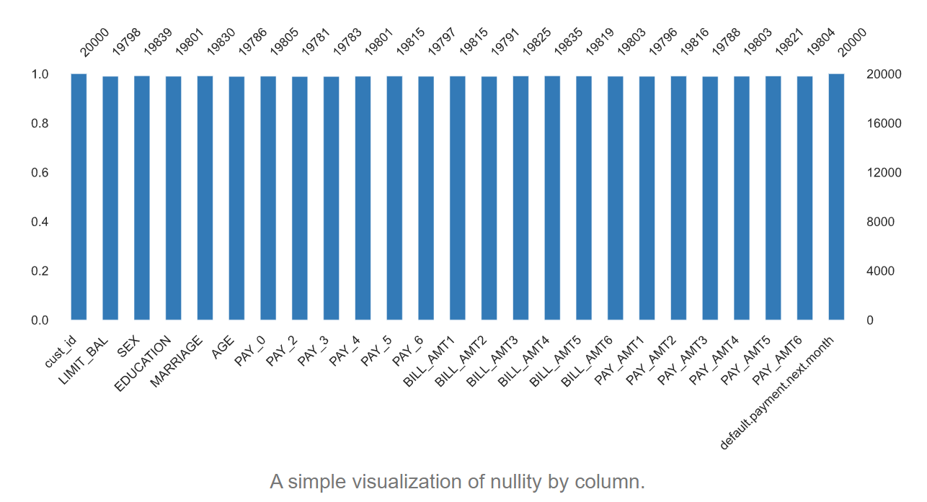
Missing values
Checking missing value
drop numerical variables with more than 30% missing values

Slide 6
Number of NAs
cust_id 0,
LIMIT_BAL 202 ,SEX 161 ,EDUCATION 199 , MARRIAGE 170 ,AGE 214,
PAY_0 195, PAY_2 219, PAY_3 217,PAY_4 199 ,PAY_5 185 ,PAY_6 203
BILL_AMT1 185 BILL_AMT2 209 BILL_AMT3 175 BILL_AMT4 165
BILL_AMT5 181 BILL_AMT6 197 PAY_AMT1 204 PAY_AMT2 184
PAY_AMT3 212 PAY_AMT4 197 PAY_AMT5 179 PAY_AMT6 196
default.payment.next.month 0
Treating NAs
_ creating binary columns to mark whether the values are nulls or not for every column
_ numerical values with mean _ categorical variables with most frequent values
_ PAY columns: all negative values to -1

Slide 7
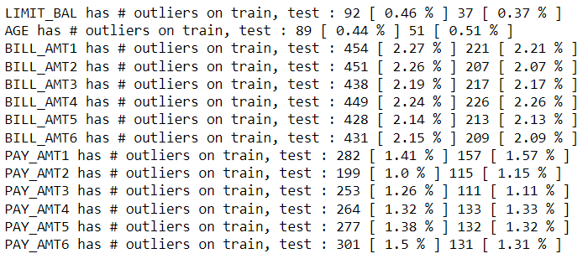
Outlier capping
(mean-3*sd, mean+3*sd)
replace outliers with upper limit and lower limit

Slide 8
Client analysis (EDA)

Slide 9
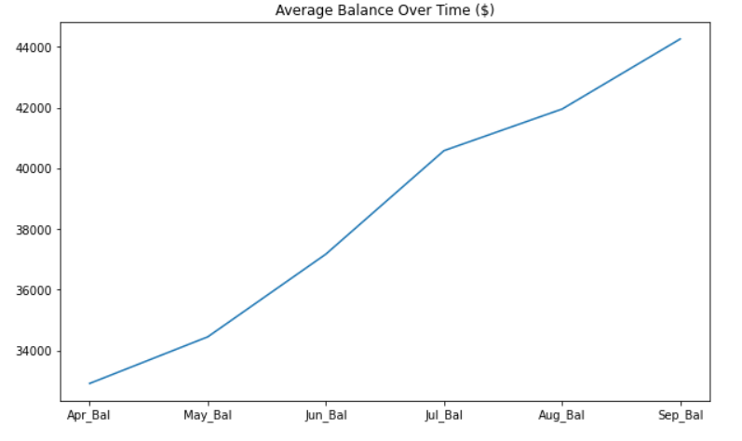
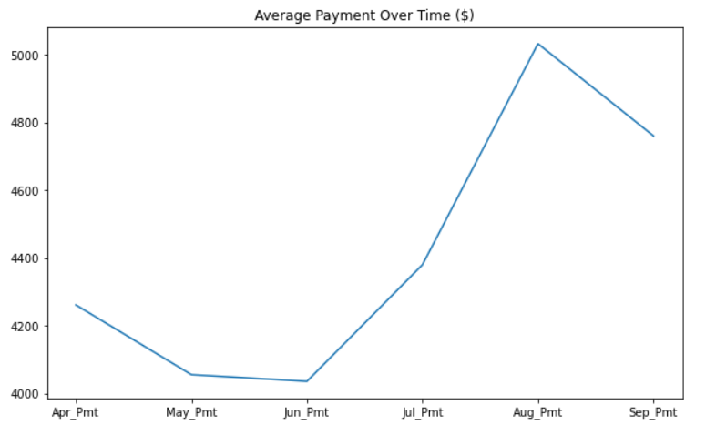

Slide 10
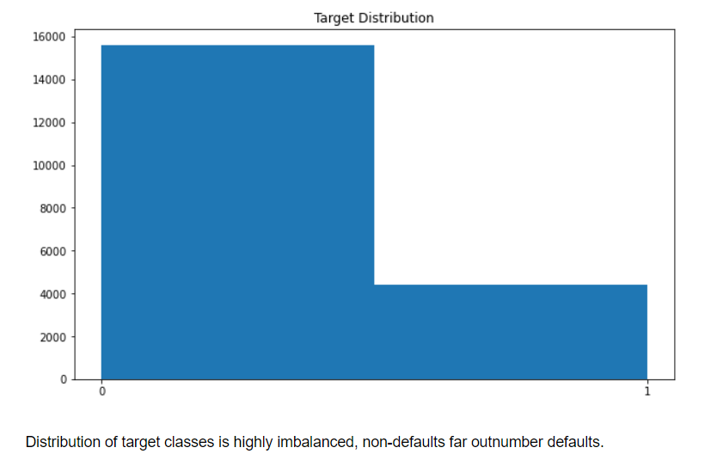

Slide 11
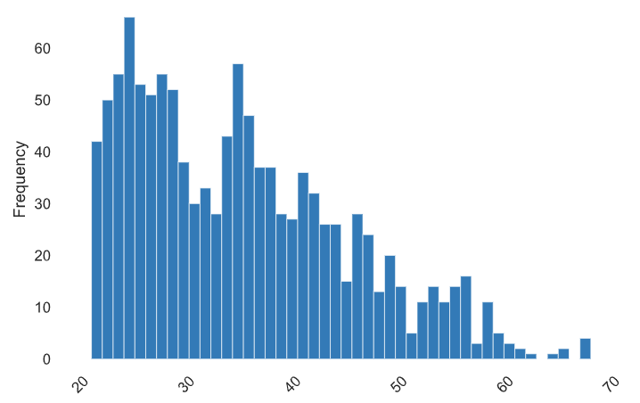
SEX & AGE distribution
Female: 56.5%
Male: 42.5%

Slide 12
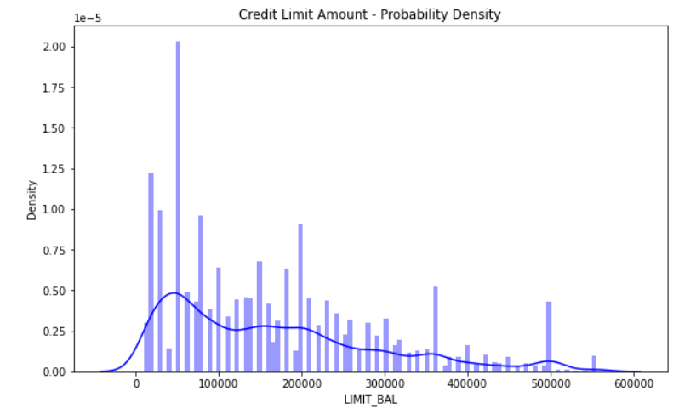

Slide 13
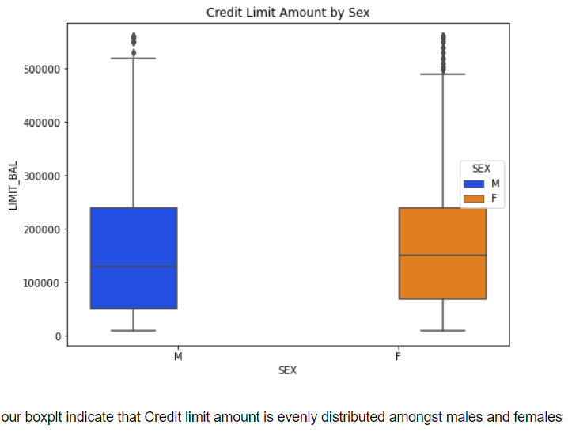
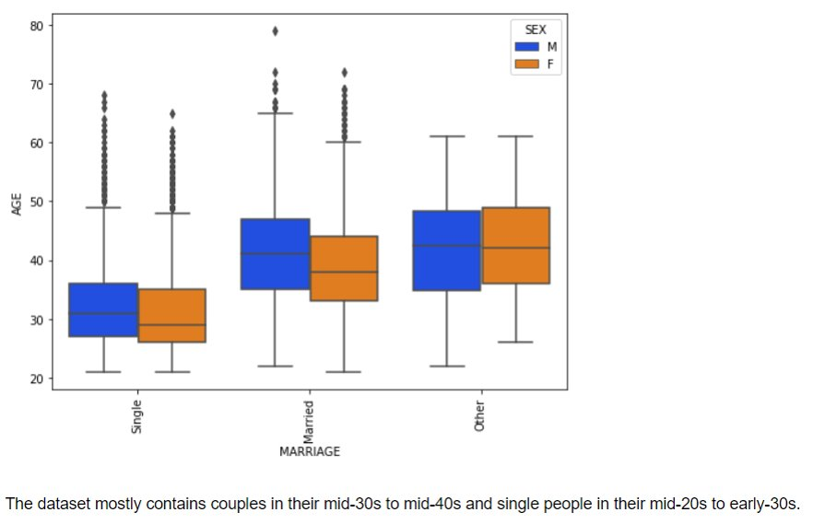

Slide 14
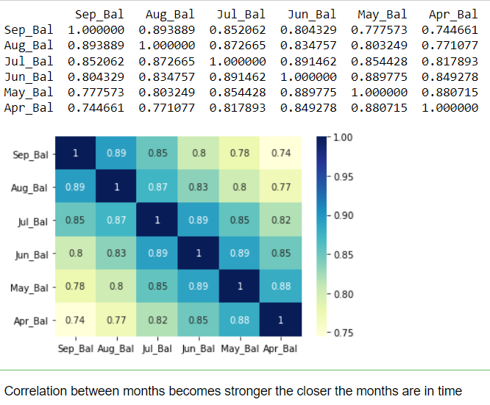
Correlation heatmap For Balance

Slide 15
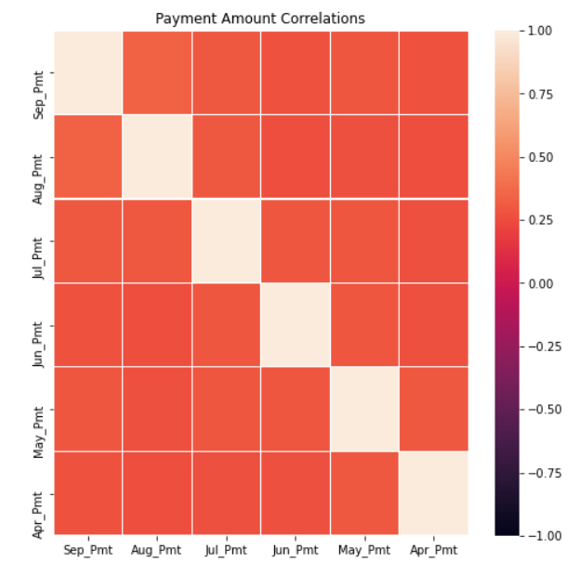
Correlation Plot Payment Status
Payment status. Correlation strength increases the closer the months are in time. For example, we could assume a late payment in August would likely lead to a late payment in September. However, it is less clear we can make the same assumption for April and September

Slide 16
2. Feature Reduction

Slide 17
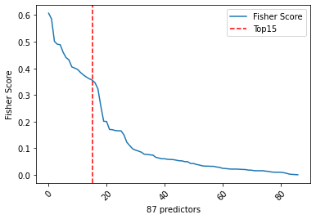
Fisher Score

Slide 18
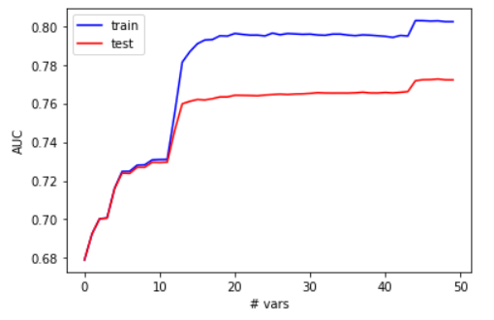
Check how AUC change when add more variables: Top n vars

Slide 19
3. Modeling

Slide 20
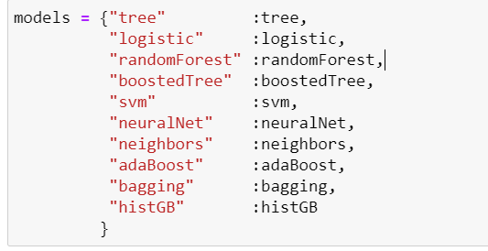
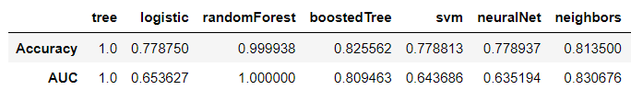
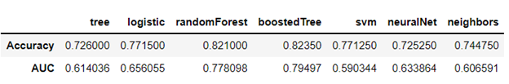
Models used :
Train:
Test:

Slide 21
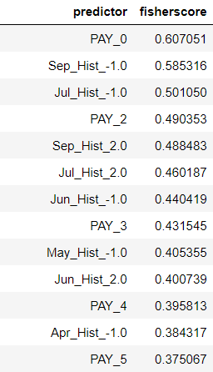
Most Influential Variables

Slide 22
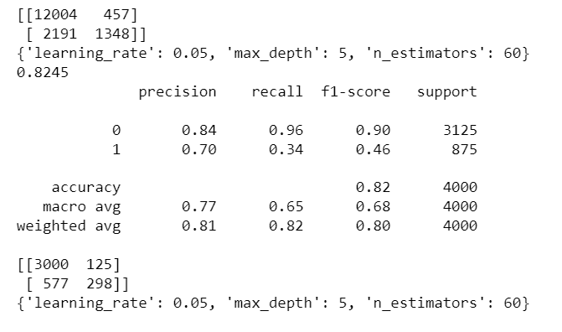


Grid Search CV on XGBoost and AdaBoost
XGBoost model AUC
AdaBoost model AUC

Slide 23
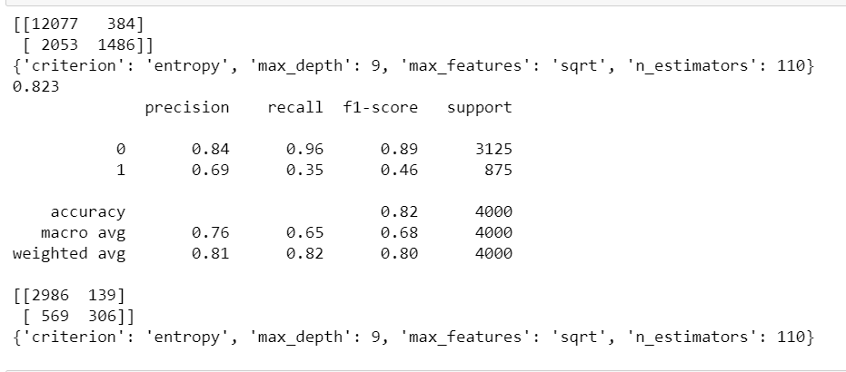

Grid Search CV on Random Forest

Slide 24
THANK YOU

